Slide 1
PROJECT ON EXCEL DASHBOARD
By
Ms. Anjali Tapase

Slide 2
FINANCE SAMPLE DATASET
INTRODUCTION
Financial data is information regarding the financial health and performance of an organization.
In this financial dataset we are deal with the segment and country wise financial stage of business by observing sales, discount, profit, COGS, etc as per the market situation.

Slide 3
FINANCIAL SAMPLE DASHBOARD
Segment By Country
Profit of country
Manufacturing Price as per Segment
Sales By Month
Sales By Country
Sales and Profit for Country
Profit and COGS for Country
Count of Products By Segment
COGS, Profit, Sales and Discount for Products

Slide 4
Segment By Country
Segment | Count of Country
Government | 153
Midmarket | 57
Channel Partners | 49
Enterprise | 43
Small Business | 37
Grand Total | 339

Slide 5
Profit Of Country
Country | Sum of Profit
Canada | $1727'K'
France | $2088'K'
Germany | $1711'K'
Mexico | $986'K'
United States of America | $1494'K'
Grand Total | $8006'K'

Slide 6
Manufacturing Price As Per Segment
Segment | Sum of Manufacturing Price
Small Business | 3748
Enterprise | 3772
Channel Partners | 4501
Midmarket | 4878
Government | 13386
Grand Total | 30285

Slide 7
Sales By Month
MONTH | Sum of Gross Sales
January | $3227'K'
February | $4742'K'
March | $3555'K'
April | $2995'K'
May | $2819'K'
June | $4768'K'
July | $5412'K'
August | $3397'K'
September | $4112'K'
October | $10386'K'
November | $4198'K'
December | $6618'K'
Grand Total | $56231'K'

Slide 8
Sales By Country
Country | Sum of Sales
Canada | $10578'K'
France | $11905'K'
Germany | $10476'K'
Mexico | $6634'K'
United States of America | $12600'K'
Grand Total | $52192'K'

Slide 9
Sales and Profit for Country
Country | Sum of Sales | Sum of Profit
Canada | $10578'K' | $1727'K'
France | $11905'K' | $2088'K'
Germany | $10476'K' | $1711'K'
Mexico | $6634'K' | $986'K'
United States of America | $12600'K' | $1494'K'
Grand Total | $52192'K' | $8006'K'

Slide 10
Profit and COGS for Country
Country | Sum of Profit | Sum of COGS
Canada | $1727'K' | $8850'K'
France | $2088'K' | $9817'K'
Germany | $1711'K' | $8765'K'
Mexico | $986'K' | $5647'K'
United States of America | $1494'K' | $11106'K'
Grand Total | $8006'K' | $44186'K'

Slide 11
Count of Product by Segment
Country | Count of Product
Channel Partners | $ 49
Enterprise | $ 43
Government | $ 153
Midmarket | $ 57
Small Business | $ 37
Grand Total | $ 339

Slide 12
COGS, Profit, Sales and Discount for Products
Country | Sum of Discounts | Sum of Sales | Sum of Profit | Sum of COGS
Amarilla | 522121 | $8201'K' | 1439890 | $6761'K'
Carretera | 741649 | $8178'K' | 1050818 | $7127'K'
Montana | 573392 | $7256'K' | 1134213 | $6122'K'
Paseo | 972623 | $13140'K' | 2233862 | $10906'K'
Velo | 658916 | $8113'K' | 993479 | $7119'K'
VTT | 570400 | $7304'K' | 1153558 | $6151'K'
Grand Total | 4039101 | $52192'K' | 8005820 | $44186'K'

Slide 13
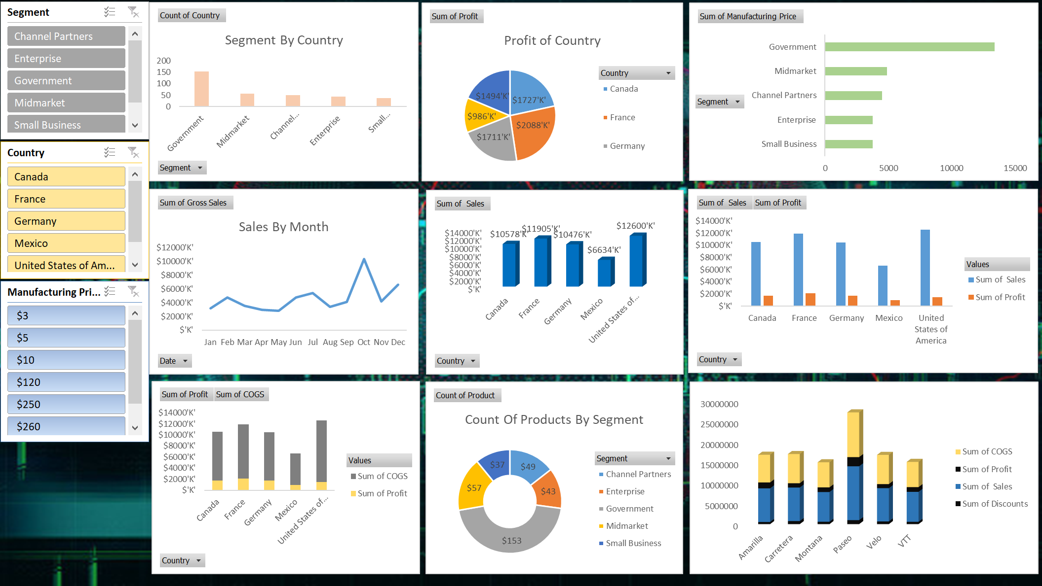
DASHBOARD ACCORING TO FINANCIAL SAMPLE DATASET

Slide 14

.

